Slide 1


IGNITE
Pitch Deck
Milestone 4

Slide 2
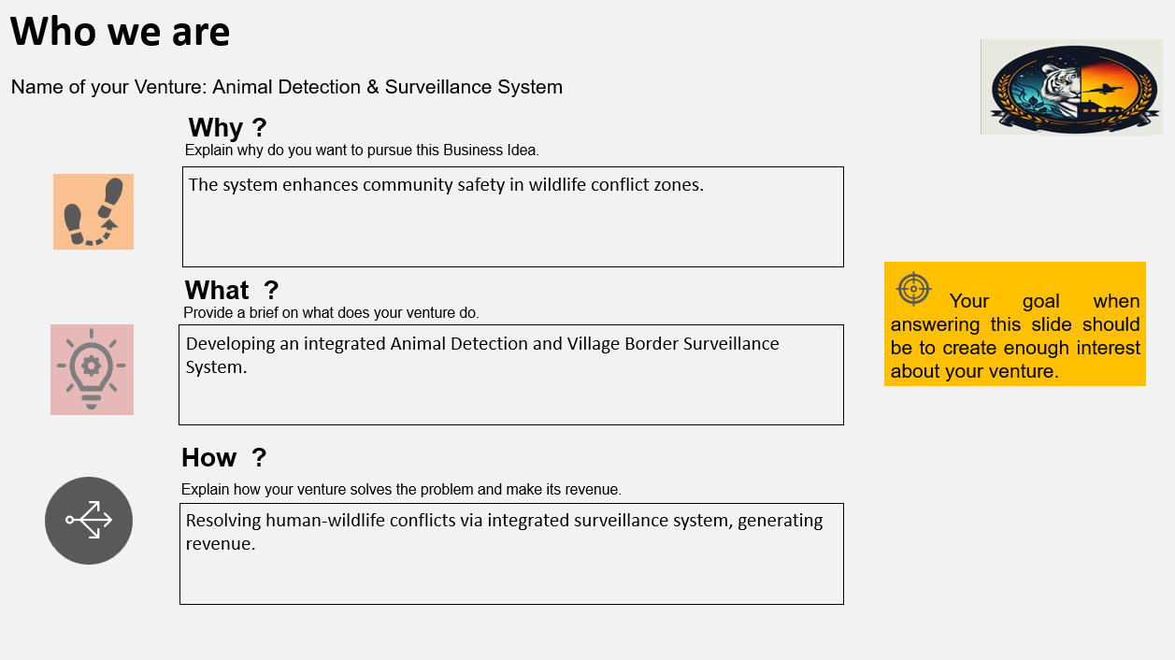



Who we are
Name of your Venture:………………………..
Place your venture logo here
Why ?
Explain why do you want to pursue this Business Idea.
What ?
Your goal when answering this slide should be to create enough interest about your venture.
Provide a brief on what does your venture do.
How ?
Explain how your venture solves the problem and make its revenue.

Slide 3
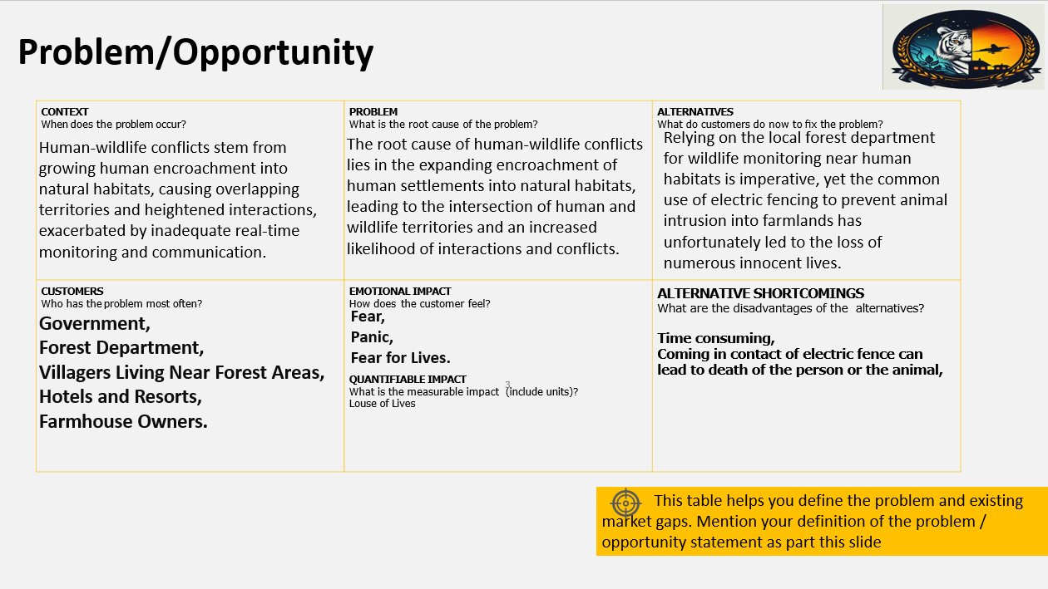
Problem/Opportunity
Place your logo here
CONTEXT When does the problem occur? | PROBLEM What is the root cause of the problem? | ALTERNATIVES What do customers do now to ﬁx the problem?
CUSTOMERS Who has the problem most often? | EMOTIONAL IMPACT How does the customer feel? | ALTERNATIVE SHORTCOMINGS What are the disadvantages of the alternatives?
 | QUANTIFIABLE IMPACT What is the measurable impact (include units)?
This table helps you define the problem and existing market gaps. Mention your definition of the problem / opportunity statement as part this slide.

Slide 4
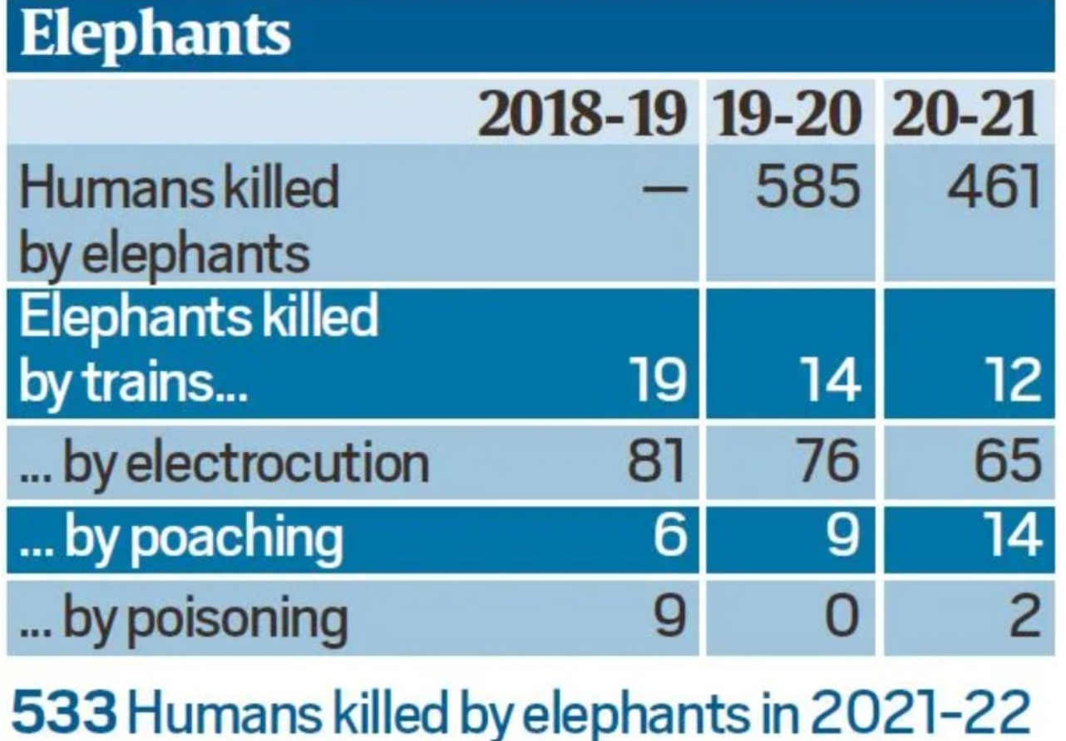
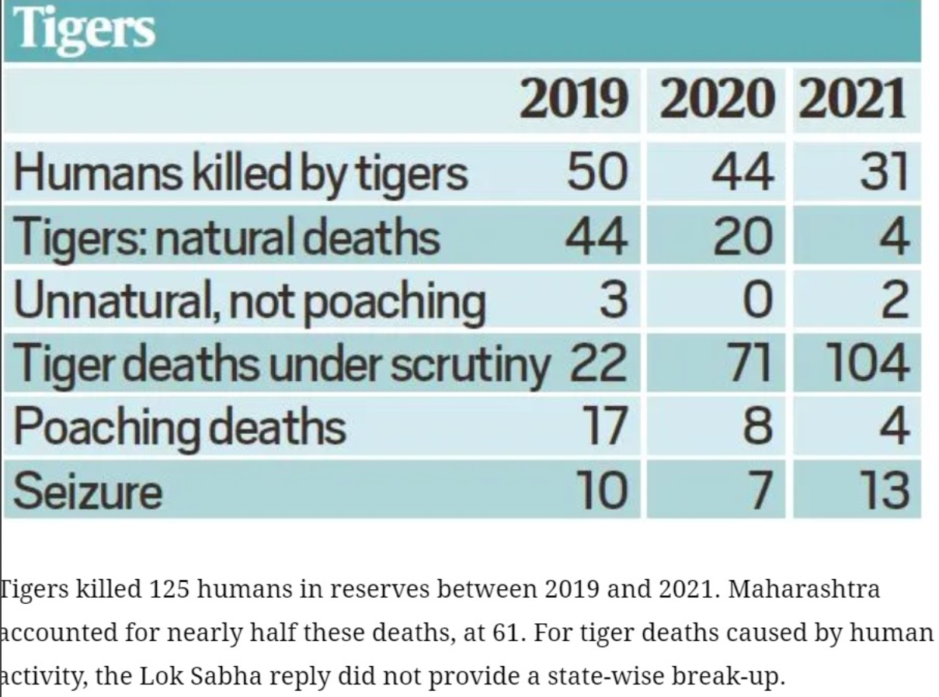
No records of leopard Attack

Slide 5

Problem Interviews And Surveys Results
Place your logo here
How many customers did you interview?
500
What was the interview mode?
online
How many of them agree this is a problem and wants a solution?
482
How many of them said they don't need a new solution?
18
The aim of this slide is to capture the customer responses to substantiate and validate the problem your venture is solving (primary and/or secondary research data). Present result analysis of the problem interviews conducted with your potential customers in graphical representation.

Slide 6
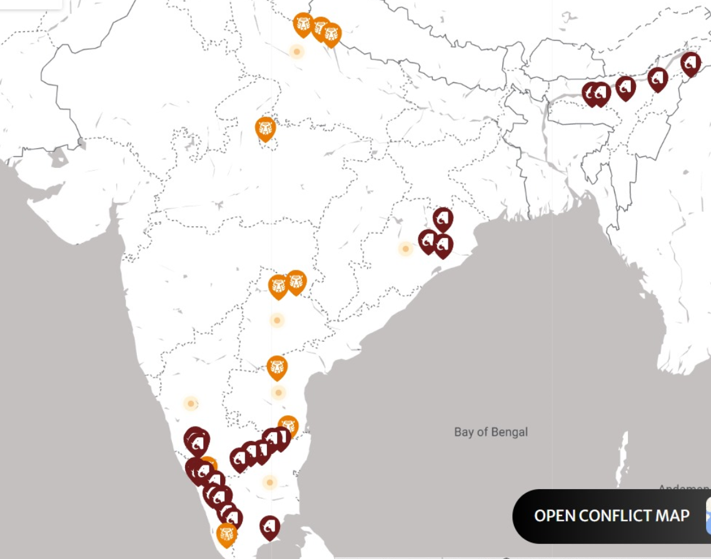

Slide 7
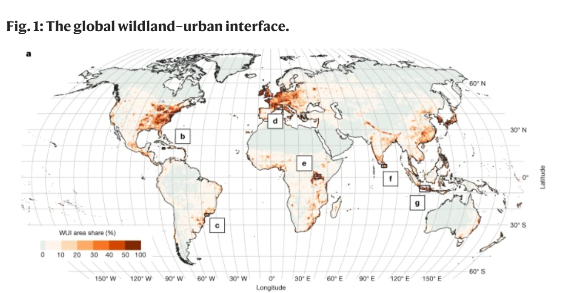

Slide 8
Market Size Estimation
Place your logo here
How to calculate market size?
1. Start with Total Addressable market- ………………………
TAM refers to the total market demand for a product or service.
If you’re entering a pre-existing space (like small business banking) you can research it and provide credible sources or reference points on how you arrived at the TAM. If you’re creating a new product or space (like Slack), you can estimate the number of customers that would want your product and approximate how much you could charge them.
2. Take your target market (SAM), within that TAM, which varies depending on geography and other logistical factors. Determine the penetration potential of your target market. This is the portion of the market you can reasonably compete with……………………………..
3.By conducting research with existing competitors, distributors etc., understand the likely penetration rate………………….
4. Multiply target market by penetration rate to find your market size…………………….
3.5 Billion People
50 Million
.
3.9 Million
This slide is to provide details on Market Size and demonstrate How big is the market opportunity your venture is pursuing. Add source/reference to the data presented.
Sources: Google

Slide 9

Customer Persona
Hard Working
Innocent
Innovist
Motivations
Goals
It include Early warning, prevention of human-wildlife conflict, crop and livestock protection, community safety, resource allocation.
Frustrations
Frustration due to animals entering their fields or farms is a common challenge, often resulting in crop damage or loss.
Border villages may face unique challenges related to animals entering their vicinity due to their proximity to wildlife habitats.
M. H. Nanjundaswamy
The aim is to collect the information about your ideal customer persona who are likely to buy your product or service. It is highly detailed, providing a clear understanding of target market and customer demographics, behaviors, needs and jobs to be done. It will help you tailor the solution/user experience through targeted design.
Age: 52
Occupation: Farmer
Location: Uttara Kannada
Bio
M. H. Nanjundaswamy from Uttara Kannada is a farmer typically works in agriculture, cultivating land and raising livestock to produce food, fiber, and other products.
He is growing Maize and he as 5acre of land.
Personality
Notes:
Time: 7 mins
Get students to brainstorm on the customer persona and VPC

Slide 10
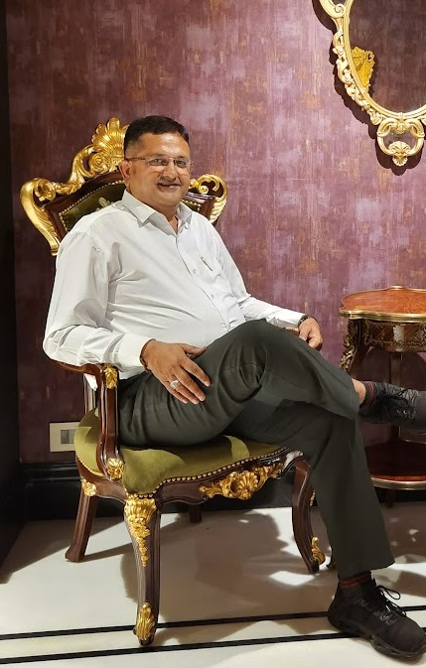
Customer Persona
Nature Lover
Excellent Negotiator
Familyman
Motivations
Goals
It include Early warning, prevention of human-wildlife conflict, livestock protection, community safety, resource allocation.
Frustrations
Frustrated due to animals entering the farmhouse and destroying their property. Many times it had happened that an leopard like dangerous animal has also entered in their property. So need to ensure the safety of the staff also.
Mr. Hiren
The aim is to collect the information about your ideal customer persona who are likely to buy your product or service. It is highly detailed, providing a clear understanding of target market and customer demographics, behaviors, needs and jobs to be done. It will help you tailor the solution/user experience through targeted design.
Age: 47
Occupation: Lawyer
Location: Gujarat
Bio
Mr. Hiren is from Gujarat who is a High Court Lawyer and also a nature lover and an adventurist. During weekends he likes to spend time with his family on his farmhouse.
Personality

Slide 11
Value Proposition Canvas
Place your logo here
.
What do you offer that makes the customers happy?
offer accurate, personalized, and 24/7 assistance to ensure customer satisfaction
I would LOVE it if:
? What would make the customer happy?
? What do the clients want when facing the problem?
This refers to the feeling/action of customers before he gets in contact with your solution.
What is the product or service that you are offering?
The offered product is a high-tech animal detection system for deep forest surveillance, identifying species via heat signatures and individual tigers through their unique stripe patterns. It alerts forest rangers with location-specific images of priority animals, such as tigers, for prompt conservation actions
Our offering relieves customer pains by providing accurate animal detection, real-time alerts, and efficient deep forest surveillance.
I would WANT:
What do the clients do (actions) when facing the problem?
This refers to the feeling/action of customers before he gets in contact with your solution.
GAIN CREATORS
FIT
GAINS
PRODUCT/
SERVICE
JOBS
PAIN KILLERS
PAINS
Which features of your offering relieve the customer's pains?
I would HATE it if:
What are the pains of the clients when facing the problem?
This refers to the feeling/action of customers before he gets in contact with your solution.
Demonstrate the fit between what you are offering and why people buy it. You must build on solution (products & service) that match their needs ( pains & gains).

Slide 12
Solution
Place your logo here
Describe your Solution:
We offer Wildlife Monitoring
The details of our offering consist of:
Animal Detection Using Heat Signatures
Tiger Identification via Stripe Patterns
Deep Forest Surveillance and Alert System
List the Benefits of Your solutions
1. Enhanced Wildlife Conservation
2. Efficient Surveillance
Notes:
Evaluation Criteria for slides 8 and 9
Check the following on the correctness of VPC: a. Have you identified the correct pains & gains; pain relievers & gain creators (2 marks) b. Have you identified the correct Jobs-to-be-done? (1 mark) c. Are the pain relievers addressing the customer pains? (1 mark) d. Have you identified the right value proposition so that the solution makes the customer's life better? (1 mark)

Slide 13
Competition Analysis
Place your logo here
Benefits | Competitor 1 | Competitor 2 | Competitor 3 | Competitor 4 | Your Venture
Product | ORLOV Trail cam | Philips CCTV | Browing Trail cam | Trueview CCTV | Animal Detection & Surveillance System
Price | 10000 Per module | 7000 per module | 15000 pre unit | 75000 pre unit | 1000 per module
Branding channels | online | Online, Stores | Online | online | Online
Packaging | Yes | Yes | Yes | Yes | Yes
Market reviews | 3 star | 5 Star | 4.4 star | 3.6 star | 5
UVP | Night vison, Motion detection | Easy Available , 2 way talk… | Wall mount, legal in the state of California | Solar powered | thermal imaging and image recognition real-time SMS
Add more as required
Identify your competitors (Direct & Indirect) and examine the list of their offerings/benefits vs your product & service. Based on what the customers say as well as your research, you need to tabulate your findings. Mention your ventures USP from the competition analysis

Slide 14
Lean Canvas
Place your logo here
PROBLEM
Human-wildlife conflicts due to encroachment into natural habitats and inadequate surveillance.
Existing Alternatives:
Traditional Monitoring
Electric Fencing
Community Reporting
Guard Dogs
Alarm Systems
SOLUTION
Detection System
Real-time Notifications
Wildlife Surveillance
UNIQUE VALUE PROPOSITION
Cutting-edge Wildlife Detection
HIGH-LEVEL CONCEPT
Real-time Wildlife Surveillance
UNFAIR ADVANTAGE
CUSTOMER SEGMENTS
Forest Departments
Farmers and Agricultural Communities
Local Village Communities near Forested Areas
EARLY ADOPTERS
Leading Wildlife Conservation Organizations
Innovative Agricultural Communities
Forward-Thinking Forest Departments
KEY METRICS
Subscribers Growth
Customer Satisfaction
Reduction in Conflict Incidents
Response Time to Sightings
CHANNELS
Online
Community Engagement
COST STRUCTURE
Development and maintenance costs
Customer support
Server infrastructure
REVENUE STREAMS
Subscription based model with tiered pricing based on usage
and features

Slide 15
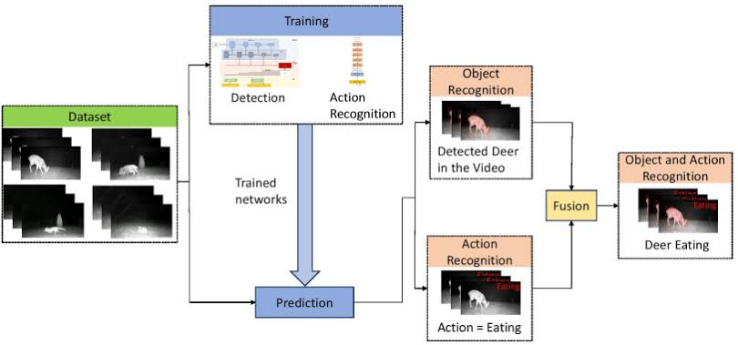
BUSINESS MODEL

Slide 16
YouTube link
https://youtu.be/T9s9xxF4XZY

Slide 17
MVP
Place your logo here
Provide Full product/service description
Insert a picture of the prototype
Provide video link of the working prototype, if any
Share screenshots of website ( Landing page, testimony etc.,). If the venture is in any online business, it must definitely showcase a functional website.
Share website link (If the venture is in any online business, it must definitely showcase a functional website.)
Share App link
Description of how the product will work and steps the customer will follow
Any other information
The slide helps to see your vision in action with a clear demonstration

Slide 18
MVP Validation
What is your MVP
Conclusion:
Test Details:Deploy system in target regions, measuring adoption rate, detection accuracy, and response time to validate effectiveness in reducing human-wildlife conflicts and enhancing community safety.
Persevere
How long will we test this MVP?
2 Months
Pivot
Not conclusive
Who is our target audience for the test? How many of them?
Forest Departments, Farmers
How will we get to that audience? government channels, conservation networks
Results of Test:
Realizations / Insights:
Did enough customers buy? Why or why not?
Yes, Because it is affordable and useful.
Did customers pay the price we expected? Why or why not?
Yes, because of the affordability .
Did customers come back to our product or show interest in doing so? Why or why not?
Yes, because of the customer satisfaction .
Next Steps:
Conduct MVP validation interview with early adopters (>10 interviews). Provide clear evidence to validate/ invalidate your solution with conclusive learning statements, and demonstrable interest in buying through this slide
Did customers recommend our product to others or evangelize about it? Why or why not?
Yes, As we also build a trust of servicing to them.
Notes:
Evaluation Criteria for slides 12 to 14
Check the following on MVP? 1. Does it look credible and showcasable? Add a picture/video of the MVP? (3 marks) 2. Have you validated the product benefits and the price with real customers? Add the MVP interview records in a Google drive and add to the PPT. (1 + 1 marks)

Slide 19
Sales Plan
Place your logo here
Customer Acquisition Plan
Customer Sales Funnel
1 | 2 | 3 | 4 | 5
Target Customer Segment (Type) | Target Customer Segment (Number) | Channels to be used to attract the target customer segment | Estimated number of leads | Estimated cost to convert these leads to actual customers
Farmers and agricultural workers | 100-200 | Online advertising , social media | 5-20 | 20,801
Livestock owners | 50-100 | Email Marketing, Content Marketing | 3-10 | 12,479
conservation organizations | 50 | Trade shows and conferences | 5-10 | 24,961
Government agencies | 100 | Website, Partnerships and sponsorships | 15-20 | 26,625
Private Landowners | 30 | Traditional Advertising, Direct sales and Outreach | 20-25 | 41,602
Research Institutions | 20-25 | Referral Programs | 5-10 | 29,121
TARGET MARKET:
2.2 Million
OPPORTUNITIES/PROSPECTS:
152065
CUSTOMER:
106915
LEADS:
200000
Ensure that the target market numbers are aligned with market sizing . The sales funnel is for one year
Notes:
Evaluation Criteria for slide 20 to 22
1. Does the venture have a Sales projections sheet with monthly sales targets and customer funnel defined for the next one year? (2 marks) 2. Does the venture have an active social media presence, such as FB, Instagram, LinkedIn? (1 mark) 3. Do you have a well-thought out brand name, logo, and a Positioning statement? (1 mark) 4. Have you made an actual sale? (1 mark)

Slide 20
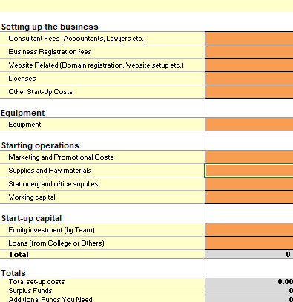
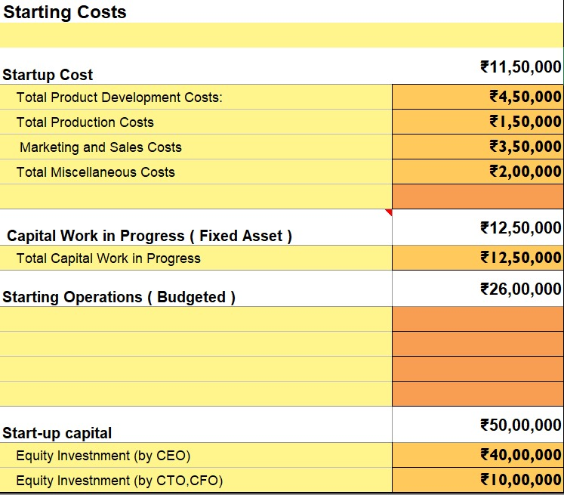
FINANCIAL PLAN
Start-up Costs
Notes:
Evaluation Criteria for slide 24
1. Have you done their Unit Economics and come up with CAC, CLV, ARPU, Net and Gross Profit? (1 mark) 2. Do you have a plan on how to reduce their CAC and churn rate, and increase their CLV, ARPU, and Net Profit Margin? (2 marks) 3. Is the capital asked for as per the Funding plan in line with the business? (1 mark) 4. How long will it take you to return the investment? (1 mark)

Slide 21

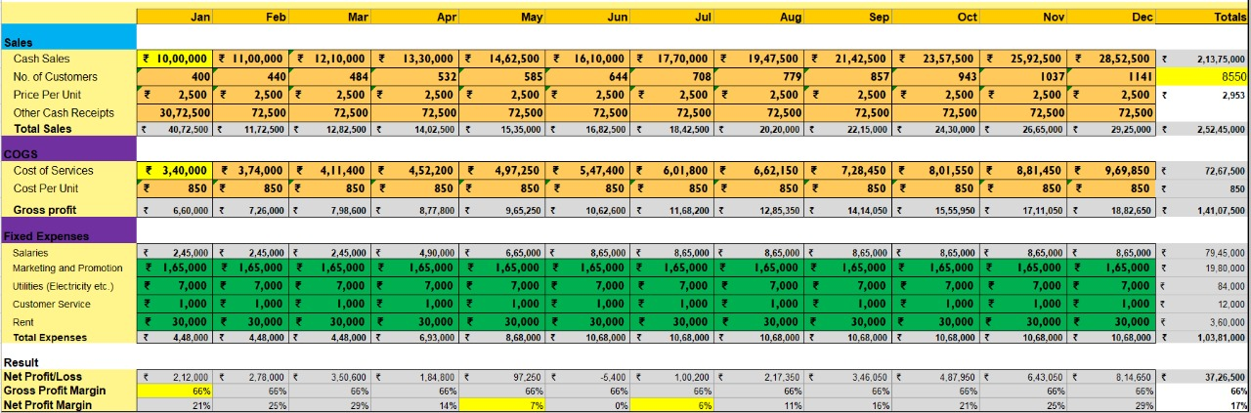
Forecast P&L
Notes:
Evaluation Criteria for slide 24
1. Have you done their Unit Economics and come up with CAC, CLV, ARPU, Net and Gross Profit? (1 mark) 2. Do you have a plan on how to reduce their CAC and churn rate, and increase their CLV, ARPU, and Net Profit Margin? (2 marks) 3. Is the capital asked for as per the Funding plan in line with the business? (1 mark) 4. How long will it take you to return the investment? (1 mark)

Slide 22
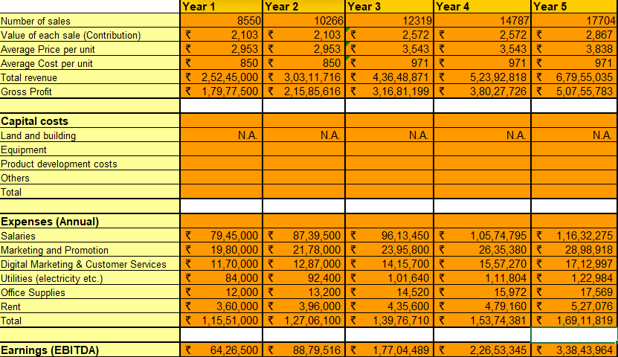
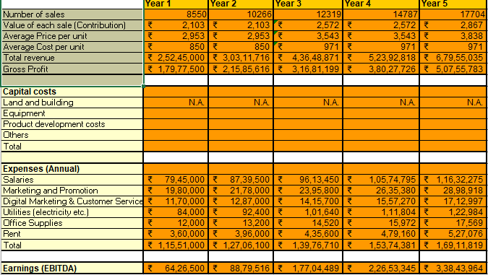
Financial Projections
Place your logo here
Notes:
Evaluation Criteria for slide 24
1. Have you done their Unit Economics and come up with CAC, CLV, ARPU, Net and Gross Profit? (1 mark) 2. Do you have a plan on how to reduce their CAC and churn rate, and increase their CLV, ARPU, and Net Profit Margin? (2 marks) 3. Is the capital asked for as per the Funding plan in line with the business? (1 mark) 4. How long will it take you to return the investment? (1 mark)

Slide 23
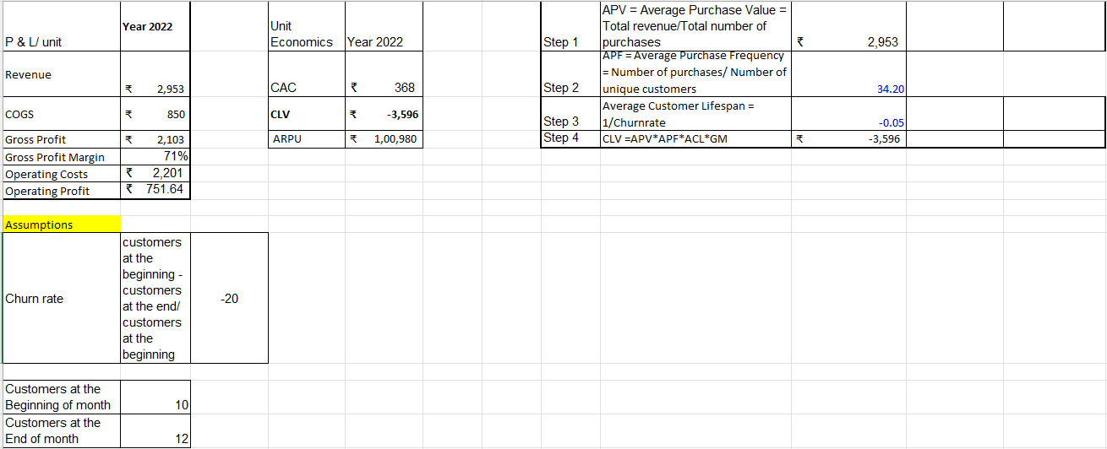
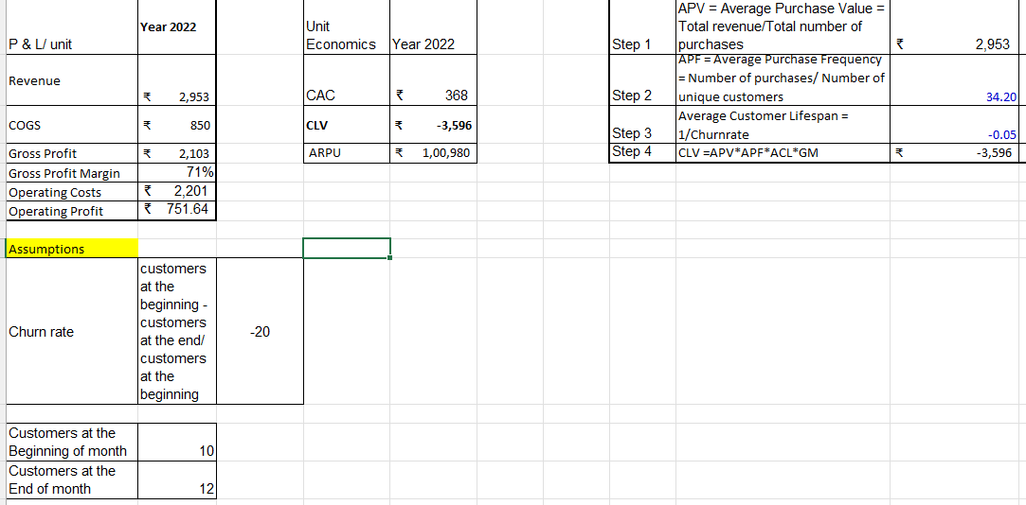
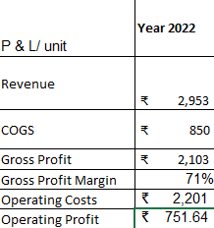
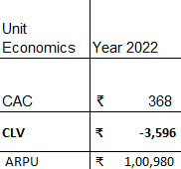
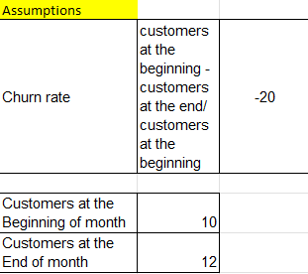
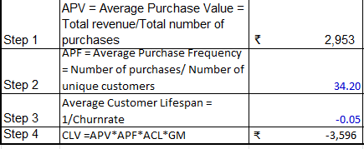
Unit Economics

Slide 24
Funding Plan
Place your logo here
How much funds required to reach to the next level of the venture?
60,00,000
How much have been bootstrapped? If not, why ?
9,05,000
How much can be bootstrapped?
5,00,000
How much external funding required? If not, why?
45,95,000
Funds utilization strategy (Details)
1. Research and Development (R&D)
2. Product Development
3. Market Research and Marketing
4. Operations and Logistics
5. Regulatory Compliance and Legal
6. Human Resources
7. Contingency Fund
Notes:
Evaluation Criteria for slide 19
1. Have you identified how much fund you need to reach the next level for the venture? (1 mark) 2. Have you bootsrapped any money till now? How much can they bootstrap?(1 mark) 3. Do you need external funding? Why or why not? (1 mark) 4. Can you explain clearly how you will utilize the money tomorrow if they get the funding today? (2 marks)

Slide 25
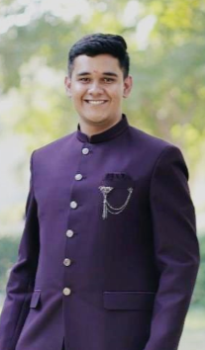
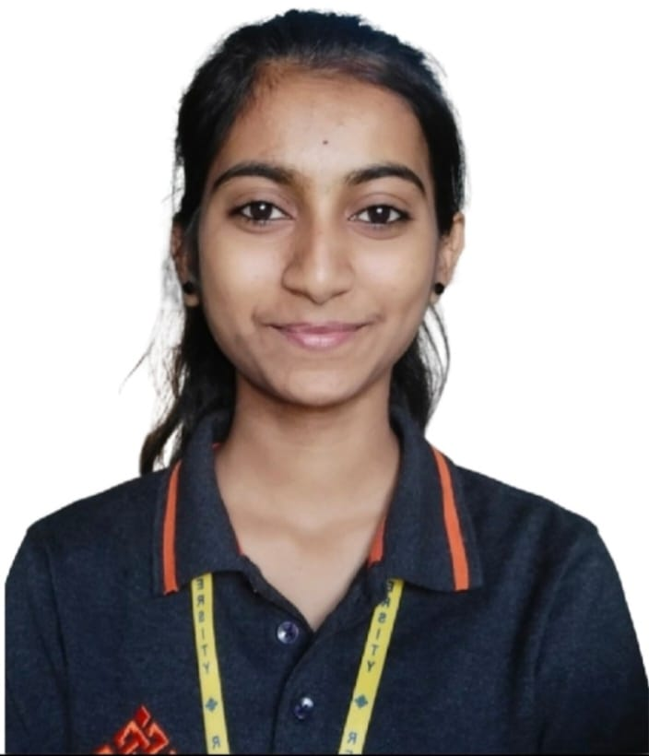
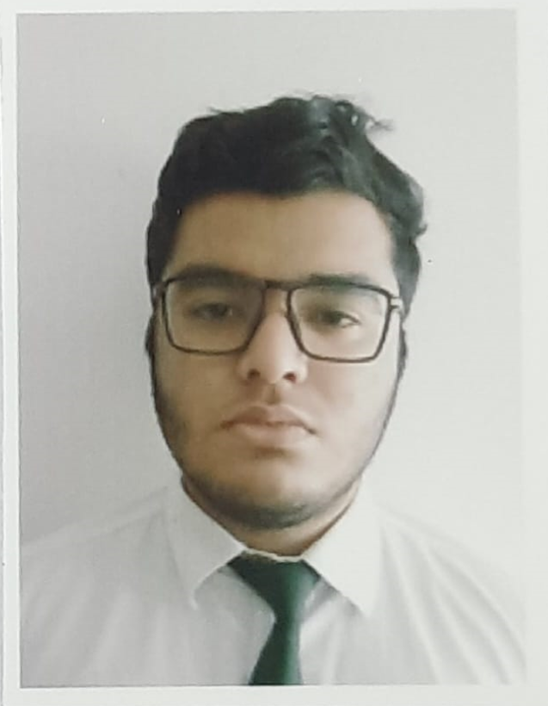
Team Composition
Place your logo here
Team member 1
Team member 2
Team member 3
Picture
Picture
Picture
What makes us a good team to solve the problem we chose?
CEO
Rushit H Jani
CTO
Dhanyashree H
CFO
Dhruv Sharma
Key Strengths and abilities
Leadership,
Vision,
Communication Skills,
Innovative Thinking,
Resilience (Learn from failures),
Connections,
Key Strengths and abilities
Facilitating Communication and collaboration across the departments
Key Strengths and abilities
communication, adaptability, and innovation
The goal is to demonstrate teams' commitment. Mention who’s on your team, defined roles, why them ( each members expertise) and their extremely relevant credentials.

Slide 26
Thank You!

